Slide 1
Nutritional Energetics is MORE than just Food
It is about Frequency & Fun

Slide 2
Nourishing your Multidimensional Body
Energy = Frequency =
2.1 million frequencies in the body
We are an amazing jumble of frequencies that have a divine design to create YOU
We need to nourish Mind, Body and Soul
And to manage our frequencies…

Slide 3
Let’s Connect with Reset Breath /Quiet Touch
The Reset Breath / Quiet Touch
https://youtu.be/q46UhcKaW2A
Cathy’s Nutritional Energetics YouTube Channel
https://www.youtube.com/channel/UCD7gSpk9texSYzdMfRmfetA/featured

Slide 4
How do we know this is so? some people are Breatharians
Physical food
Water
Etheric “food”
Physical Body
Food
Qi
Water

Slide 5
Why care about a “Cosmic - Quantum Nutrition”??
The way food is grown : soil, minerals, toxins, organic not Food is not the way it was meant to be – it into necessarily “the best” – even the organic and farm grown
The way food is processed for consumption
Toxins, high heat, additives, etc They deplete nutrients and change the molecules
The energies it is subject to along the way to your house
From xray, to personal and people frequencies of handlers

Slide 6
How can we have a “Cosmic Kitchen”
With Frequencies and Infusions
Charging our Waters
Upping the Vibe of Foods
Cooking with Charged Waters
Adding Superfoods and Super Herbs to foods

Slide 7
Cosmic Nutrition – How can we nourish our Divine Blueprint the way it is meant to be *******With Frequencies and Infusions
Food Frequency Numbers
Positive words on Food jars
(angry bee honey …no,no,no)
Colors of jars
. . .

Slide 8
Cosmic Nutrition – How can we nourish our Divine Blueprint the way it is meant to be
Waters – Infused with frequency
Use Frequency Numbers
Use my custom water videos
blank slate, prepare, charge water
Colors of Foods / Colors of Chakras
each color is a different nutrient

Slide 9
Why do I show a crop circle to explain Nourishing the Multidimensional Body in 9D???
Crop circle
Nourishing 9D Logo

Slide 10
1-9 D Quicky via “Dimensions”
“Dimensions” per Alchemy of Nine Dimensions
by Barbara Hand Clow and the Pleiadeans
1 Iron core crystal , blood ( both at Schumann resonance)
we need the frequency blueprint to create the divine blueprint of “it”
2 Minerals, crystals, microbiome of the body
3 Surface of earth and physical body

Slide 11
Why do I show a crop circle to explain Nourishing the Multidimensional Body in 9D???
Crop circle
Nourishing 9D Logo

Slide 12
1-9 D Quicky
4 Emotions Canopy (emotional release : EC and FIX)
5 Heart (release heart walls, Triad Wave,
RB-QT)
6 Geometric Forms ( glyphs, art etc )
7 Sound (voice print, (real) music, tones)
8 Light (Lightwave, Color)
9 Source Energy (Life Force, Qi Gong)

Slide 13
Why do I show a crop circle to explain Nourishing (in) 9D???
Crop circle
Nourishing 9D Logo

Slide 14
Our Energies and Frequencies: Energy INCOME is energy / frequency coming “in” Energy Management How is your body using it Energy Output How is your body expressing it Is it “producing” Life Force

Slide 15
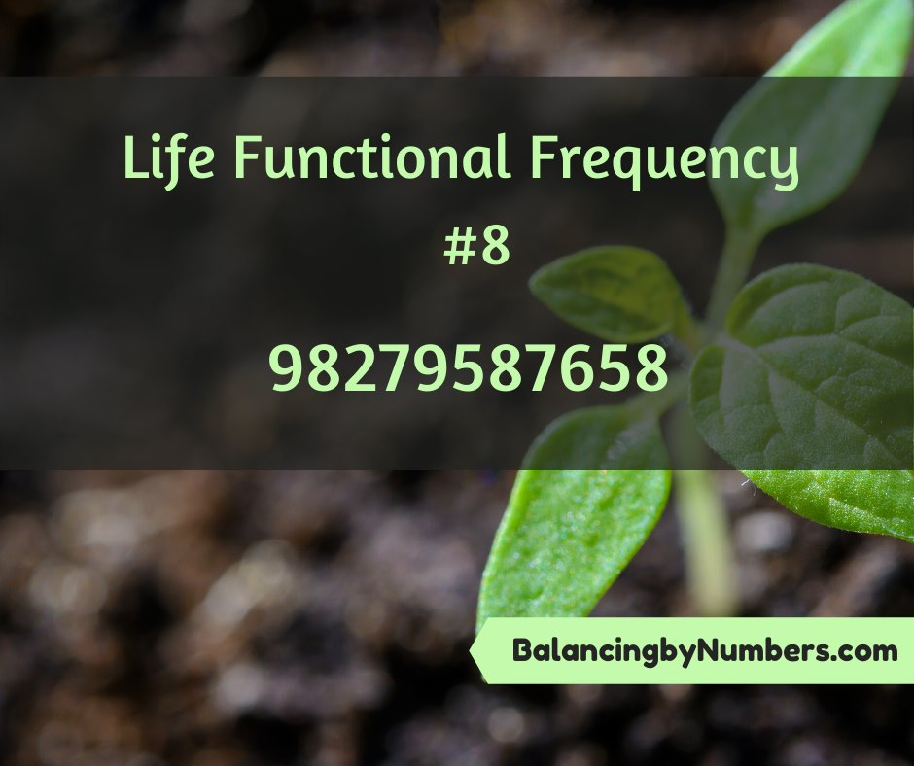
Frequency Recipes
Immune System Boosting Assisting Frequency - 36 1192 48 1 0 22 15 8
Because Anahata Codes are balancing frequencies, this frequency will optimize your own immune system by singing an energetic song of optimization to your entire immune system.
Lemon Essential Oil Assisting Frequency – 4915 2973 6 8 124 97 11 5612
Lemon essential oil has a detoxing effect. It rids the body of toxic build up and cleanses your blood. It also has antibacterial qualities.
Cinnamon Bark Essential Oil Assisting Frequency - 77698 23 43 48 29 36
Cinnamon Bark Essential Oil stimulates the immune system. It is a natural antiviral and antibiotic.

Slide 16
Add this to our milk carton

Slide 17
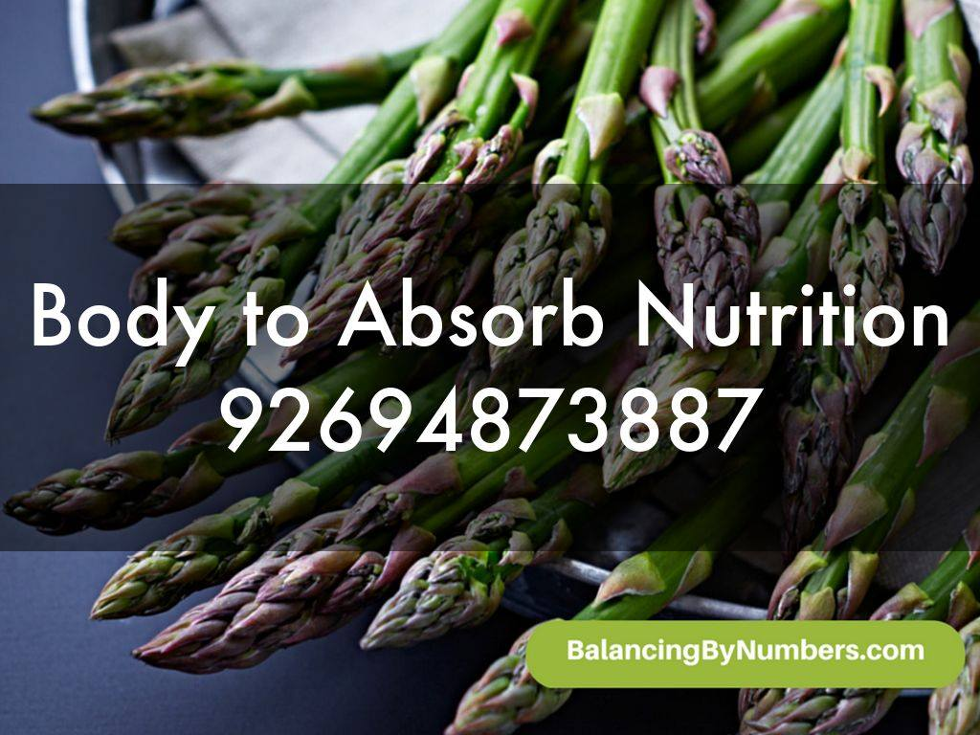
Example….
Place this
on you or
In your fridge or
In your kitchen
etc

Slide 18
Place this
on a pitcher of water
On a glass of lemonade
On your Vitamin C supplement jar

Slide 19
Place this
on a pitcher of water
On your tree
In your bra or in your sock
Say it 7 times to hold in your field

Slide 20
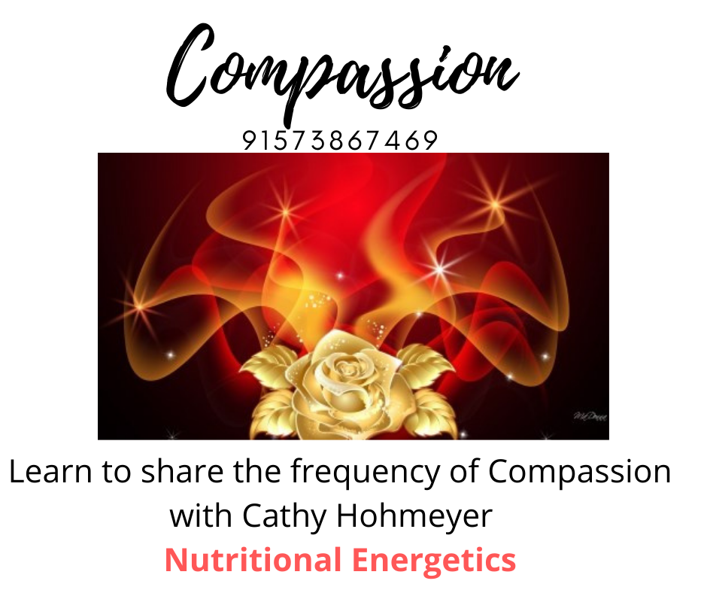
Place this
on your office water cooler
In your bra or in your sock
Say it 7 times to hold in your field
Tape it on a light pole

Slide 21
Water store in this …………………..not this

Slide 22
Water Charging
Wands
Vortex pitchers
Intentions / Blessings
Water charging programs /custom intents

Slide 23
Upping the Vibe of Food
Place food on activators
Your own geometric forms
Note : Roses are a 5D flower, use images of roses
Essential Oils

Slide 24
What to expect in a Session with VP
Review the words
Just look at what you might know
Research a little if you want to
Review the Green sheet
In session we can
Do an Energy session on the important things “not working in the VP”
Or an issue in general

Slide 25
BioPhotons
In 1974, Fritz-Albert Popp demonstrated that all living systems absorb and emit coherent biophotons and that healthier people emit stronger biophotons than people who are ill.. When he measured the biophotons of food he found that organic, wild grown food had the highest amount of biophotons, followed by cultivated organic crops and lastly, conventionally grown crops.

